Slide 1
Theology and Economics

Slide 2
Theology and Economics
Part 2 (or 3)

Slide 3
What is economics?
“A social science that studies how individuals, governments, firms and nations make choices on allocating scarce resources to satisfy their unlimited wants”

Slide 4
Part 1
It’s a new world order

Slide 5
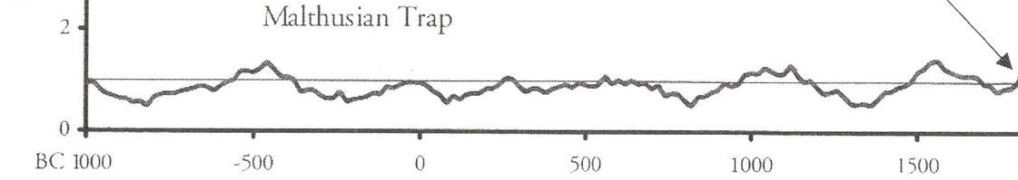
Economic History of the World

Slide 6
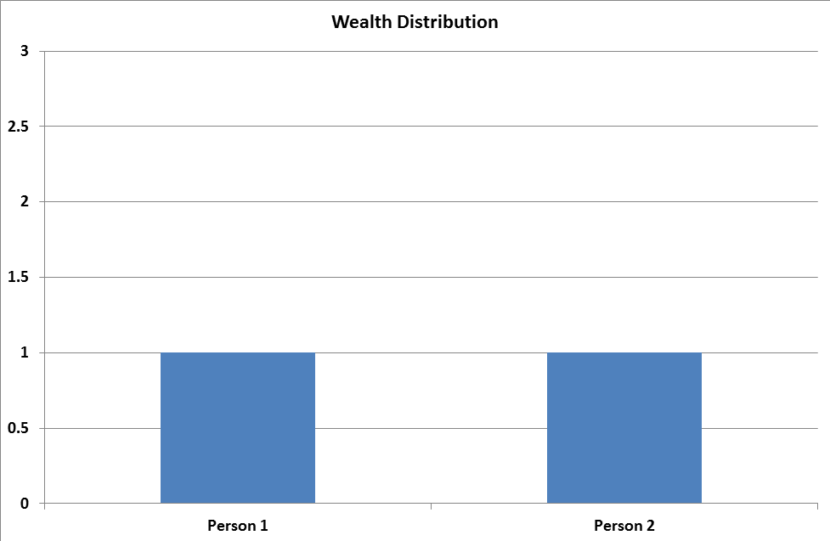
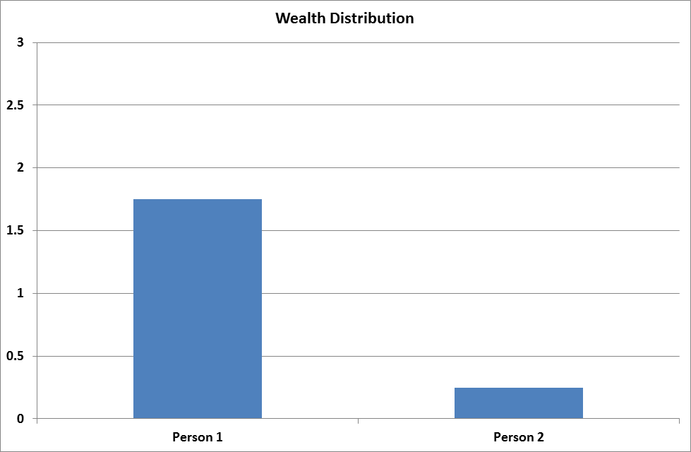
Zero Sum?

Slide 7
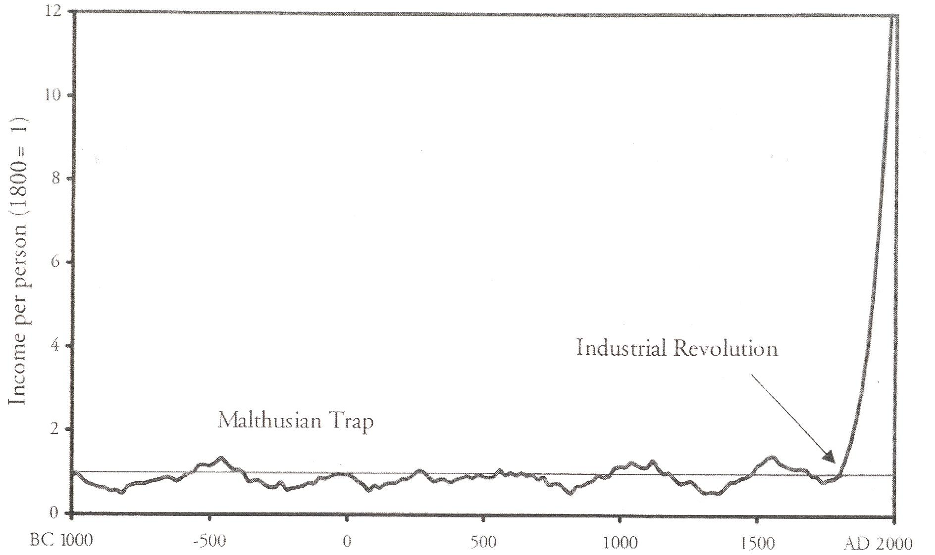

Slide 8
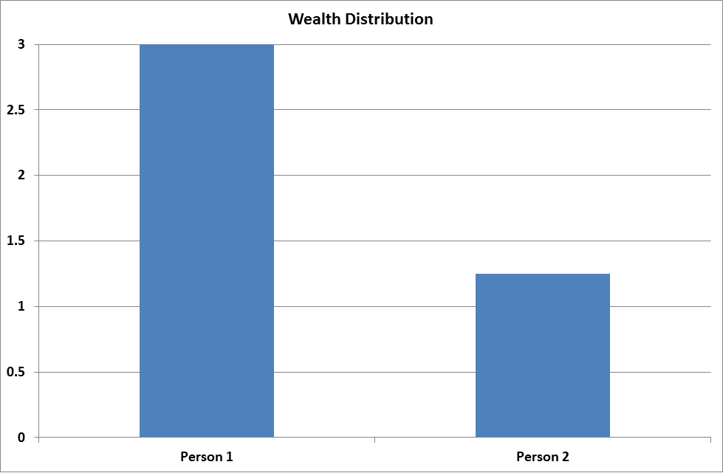
Zero Sum?

Slide 9
Different Reality

Slide 10
Different Reality
Still think/behave like we are operating here

Slide 11
Biblical revision?

Slide 12
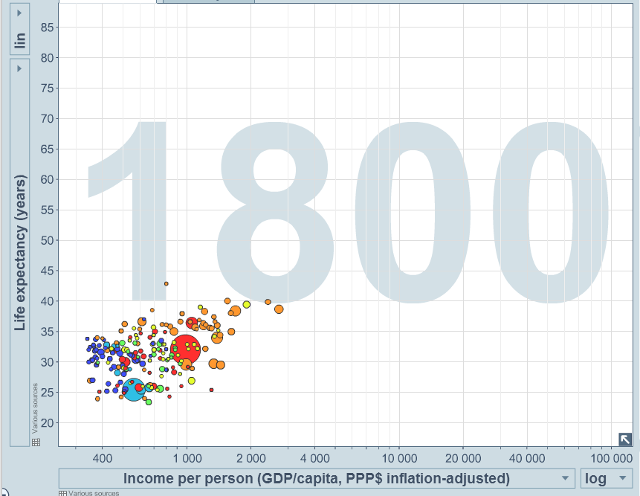
Life Expectancy

Slide 13
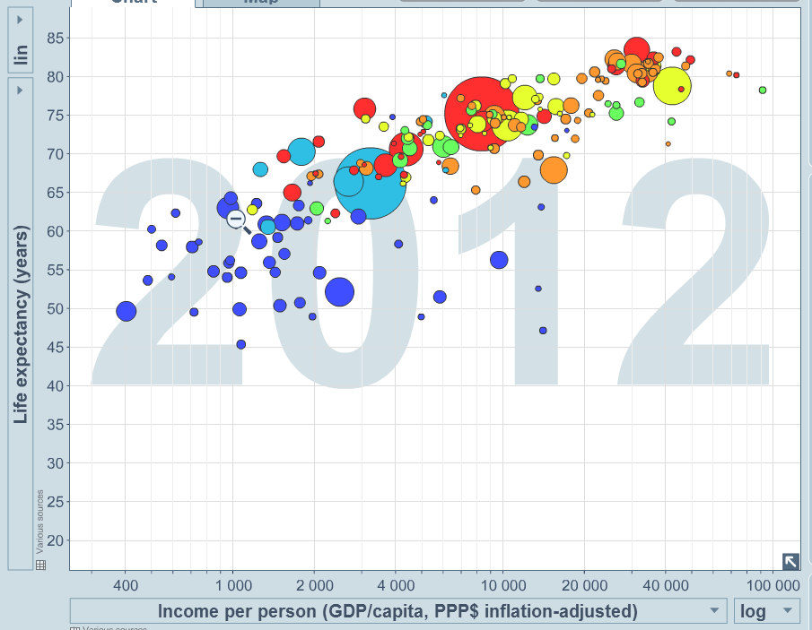
Life Expectancy

Slide 14
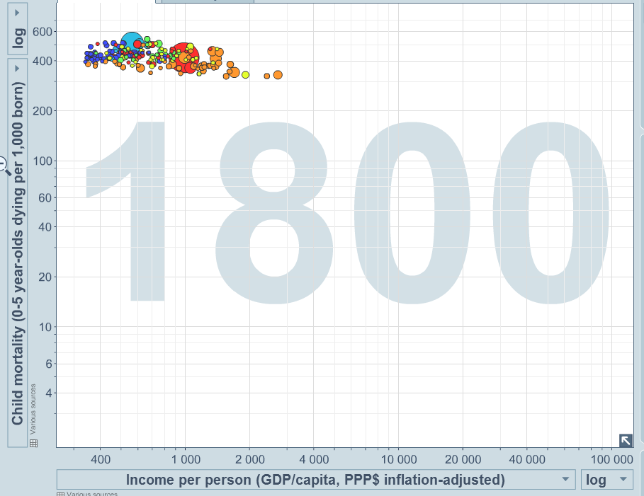
Infant Mortality

Slide 15
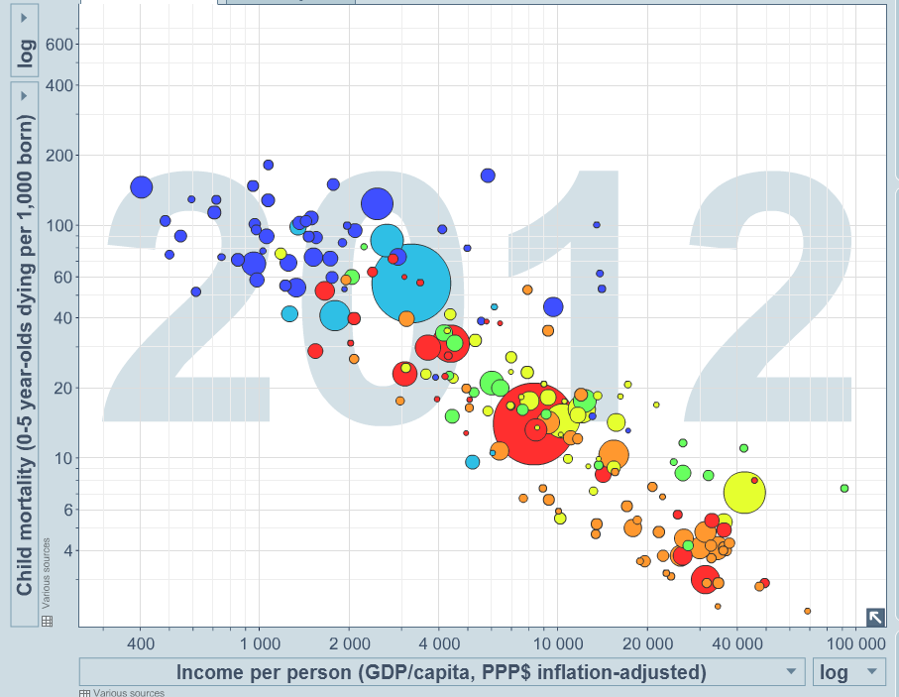
Infant Mortality

Slide 16
Question 1
How should I spend my money?

Slide 17
Question 1
How should I spend my money?
How would an economists answer that?

Slide 18
Good 2
Good 1

Slide 19
Bananas
Apples

Slide 20
Bananas
Apples

Slide 21
Bananas
Apples

Slide 22
Bananas
Apples

Slide 23
Bananas
Indifference/Preference Curve
Apples

Slide 24
Bananas
Which is better?
Apples

Slide 25
Bananas
Apples

Slide 26
Bananas
Apples

Slide 27
Bananas
Apples

Slide 28
Bananas
Apples

Slide 29
Bananas
Apples

Slide 30
Bananas
Apples

Slide 31
“ Normal” Goods
More is better
Mix is better (Convex)
Bananas
Apples

Slide 32
At population level virtually everything is a “ Normal” good

Slide 33
Constraints?
You only have so much - budget

Slide 34
Budget = $10, Apple = $1 and Banana = $1
Bananas
10
10
Apples

Slide 35
Budget = $10, Apple = $1 and Banana = $1
Bananas
10
7
3
10
Apples

Slide 36
Budget = $15, Apple = $1 and Banana = $1
Bananas
15
10
8
7
3
8
10
15
Apples

Slide 37
Bananas
10
7
3
10
Apples

Slide 38
Budget = $10, Apple = $1 and Banana = $0.67
Bananas
15
10
7
3
8
10
Apples

Slide 39
Budget = $10, Apple = $1 and Banana = $0.67
Bananas
15
11
10
7
3
8
10
Apples

Slide 40
Bananas
10
7
3
10
Apples

Slide 41
Preference Curves Change
Bananas
10
7
3
3
7
10
Apples

Slide 42
Economists answer to Question 1
Choose the mix of goods that puts you on the highest preference curve – pursue your own self interest.

Slide 43
Economists answer to Question 1
Choose the mix of goods that puts you on the highest preference curve – pursue your own self interest.
“Self-interest is no myopic selfishness. It is whatever it is that interests the participants, whatever they value, whatever goals they pursue. The scientist seeking to advance the frontiers of there discipline, the missionary seeking to convert infidels to the true faith, the philanthropist seeking to bring comfort to the needy – all are pursuing their interests, as they see them, as they judge them by their own values.”
  Milton Friedman

Slide 44
What I would have done

Slide 45
Infant Mortality

Slide 46
Why did infant mortality drop?

Slide 47
Why did infant mortality drop?
We got wealthier

Slide 48
Infant Mortality

Slide 49
Infant Mortality

Slide 50
Why did infant mortality drop?
We got wealthier
The price got cheaper

Slide 51
Infant Mortality
$700

Slide 52
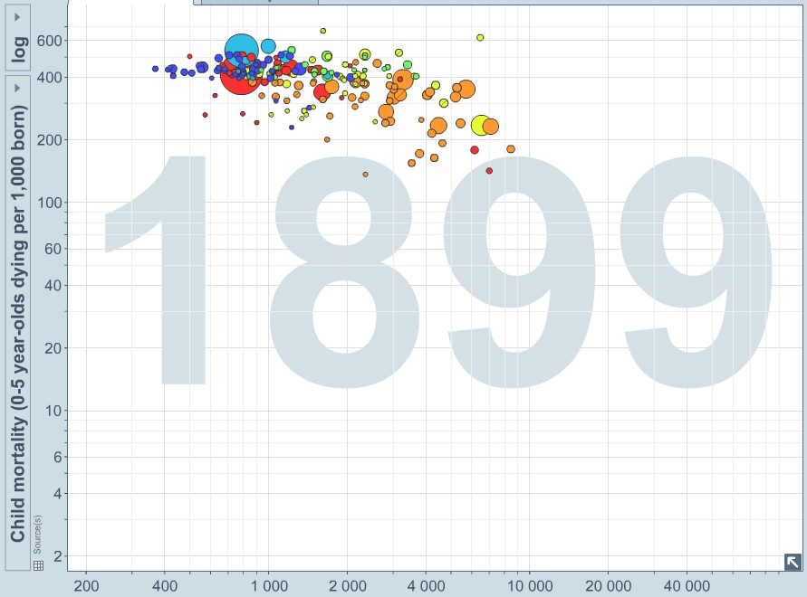
Infant Mortality
$7000

Slide 53
Why did infant mortality drop?
We got wealthier
The price got cheaper
We love our kids more (preference curves change)

Slide 54
Three Models of Change

Slide 55
Three Models or Change
We got wealthier
The price got cheaper
Preference curves change

Slide 56
Three Models or Change
We got wealthier
The price got cheaper
Preference curves change
Economists

Slide 57
Economics vs Theology
Economics
  Don’t assume preference curves change (at least quickly)
  Any “change” is just revealed preferences
  People respond to incentives
  Overlay conditions on people to make them behave better

Slide 58
Economics vs Theology
Economics
  Don’t assume preference curves change (at least quickly)
  Any “change” is just revealed preferences
  People respond to incentives
  Overlay conditions on people to make them behave better
Theology
  We are becoming “Children of God”
  What are you when the resources dry up?

Slide 59
Warren Buffet
“Of the billionaires I have known, money just brings out the basic traits in them. If they were jerks before they had money, they are simply jerks with a billion dollars.”

Slide 60
What I think
80-90% of change is not real change
Feedback loops
Support economic growth – grow the pie
Golden Womb - be an active part of the debate on cutting up the pie (another sermon?)
There might be cultural factors
Optimise part 1 - what do you really want?

Slide 61
What I think
80-90% of change is not real change
Feedback loops
Support economic growth – grow the pie
Golden Womb - be an active part of the debate on cutting up the pie (another sermon?)
There might be cultural factors
Optimise part 1 - what do you really want?
Always know the limitations and risks

Slide 62
Dueteronomy – part of chpt 8-10
(8) 11-16 Make sure you don’t forget God, your God, by not keeping his commandments, his rules and regulations that I command you today. Make sure that when you eat and are satisfied, build pleasant houses and settle in, see your herds and flocks flourish and more and more money come in, watch your standard of living going up and up—make sure you don’t become so full of yourself and your things that you forget God, your God,………

Slide 63
17-18 If you start thinking to yourselves, “I did all this. And all by myself. I’m rich. It’s all mine!”—well, think again. Remember that God, your God, gave you the strength to produce all this wealth so as to confirm the covenant that he promised to your ancestors—as it is today……
(9)12-13 So now Israel, what do you think God expects from you? Just this: Live in his presence in holy reverence, follow the road he sets out for you, love him, serve God, your God, with everything you have in you, obey the commandments and regulations of God that I’m commanding you today—live a good life.

Slide 64
(10) 14-18 …So cut away the thick calluses from your heart and stop being so wilfully hard-headed. God, your God, is the God of all gods, he’s the Master of all masters, a God immense and powerful and awesome. He doesn’t play favourites, takes no bribes, makes sure orphans and widows are treated fairly, takes loving care of foreigners by seeing that they get food and clothing.

Slide 65
How should I spend my money?
Optimisation part 2
Christians live in a different economy, prices are different. (immediate optimisation change)
  What is the value of your soul?
  Crazy economy of Grace

Slide 66
How should I spend my money?
Optimisation part 2
Christians live in a different economy, prices are different. (immediate optimisation change)
  What is the value of your soul?
  Crazy economy of Grace
Constant alignment with God – becoming a Child of God. (slow preference curve changes)

Slide 67
How should I spend my money?
Optimisation part 2
Christians live in a different economy, prices are different. (immediate optimisation change)
  What is the value of your soul?
  Crazy economy of Grace
Constant alignment with God – becoming a Child of God. (slow preference curve changes)
Active engagement with God and Life
  Jacob wrestling the angel

Slide 70
Possible extra slides

Slide 71
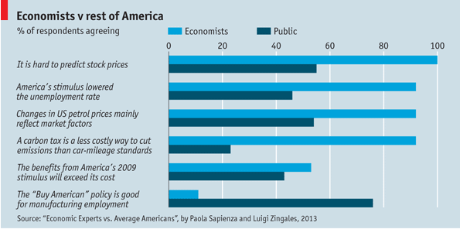
Image Problems

Slide 72
Theme 1
Foundations of economics

Slide 73
What is growth?
Improved Productivity
  One person can produce more = choices
    1870 – 70-80% working in agriculture (USA)
    2008 - <2% - output 18 x 1870’s
    Unemployment 1870’s - 6%, 2008 (ish) = 6%
More efficient

Slide 74
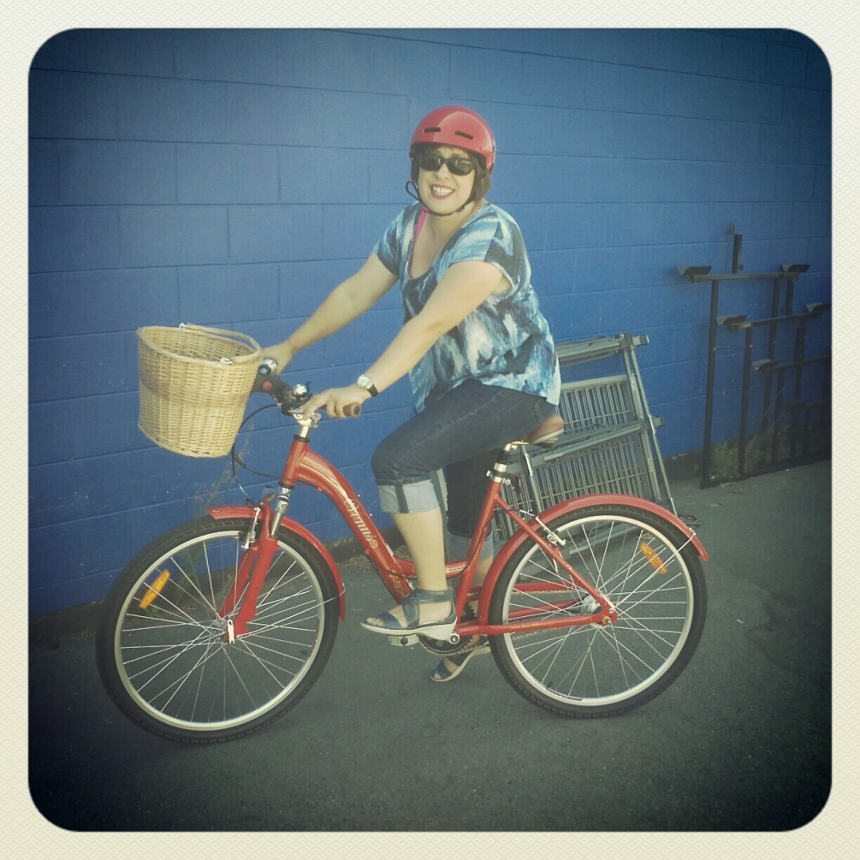
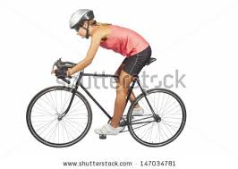
Which do you prefer?

Slide 75
Which do you prefer?

Slide 76
Which do you prefer?
Rusty Chain

