Slide 1
Theology and Economics

Slide 2
Image Problems
What do you immediately think about when you hear economics?

Slide 3
What is economics?
“A social science that studies how individuals, governments, firms and nations make choices on allocating scarce resources to satisfy their unlimited wants”

Slide 4
Theme 2
It’s a new world order

Slide 5
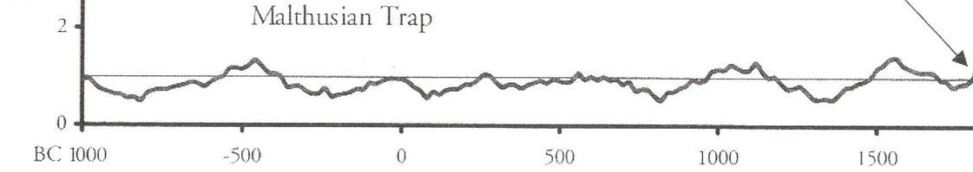
Economic History of the World

Slide 6
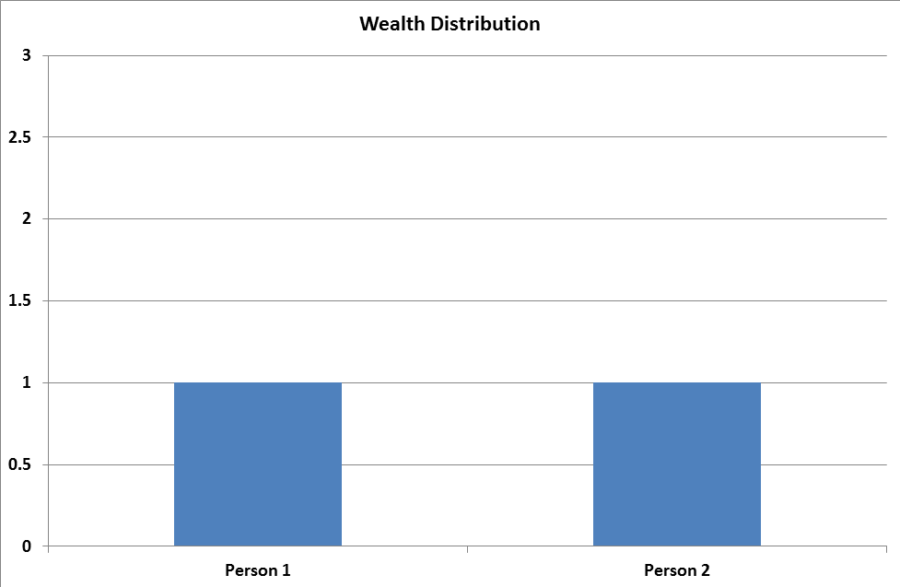
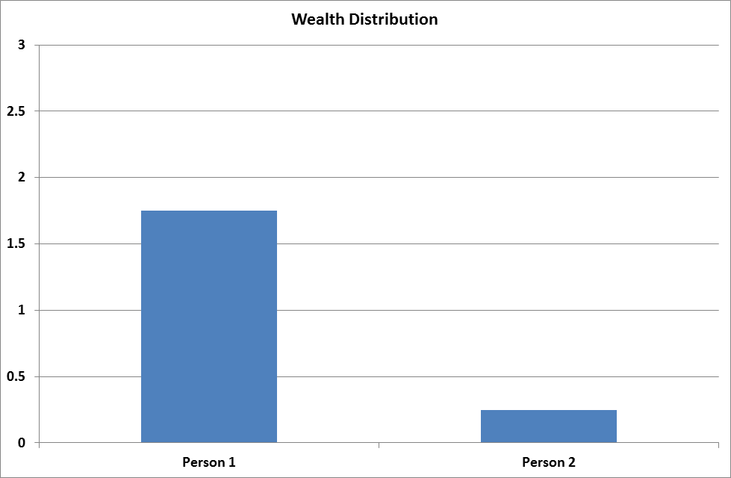
Zero Sum?

Slide 7
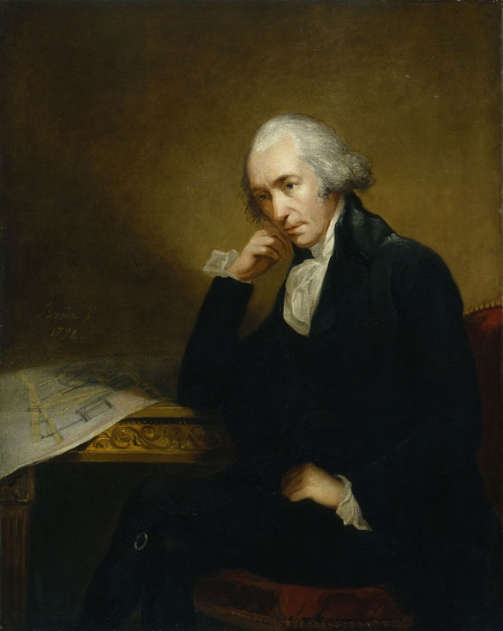
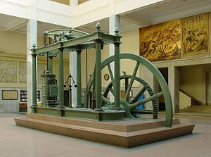
Engineers Change the World

Slide 8
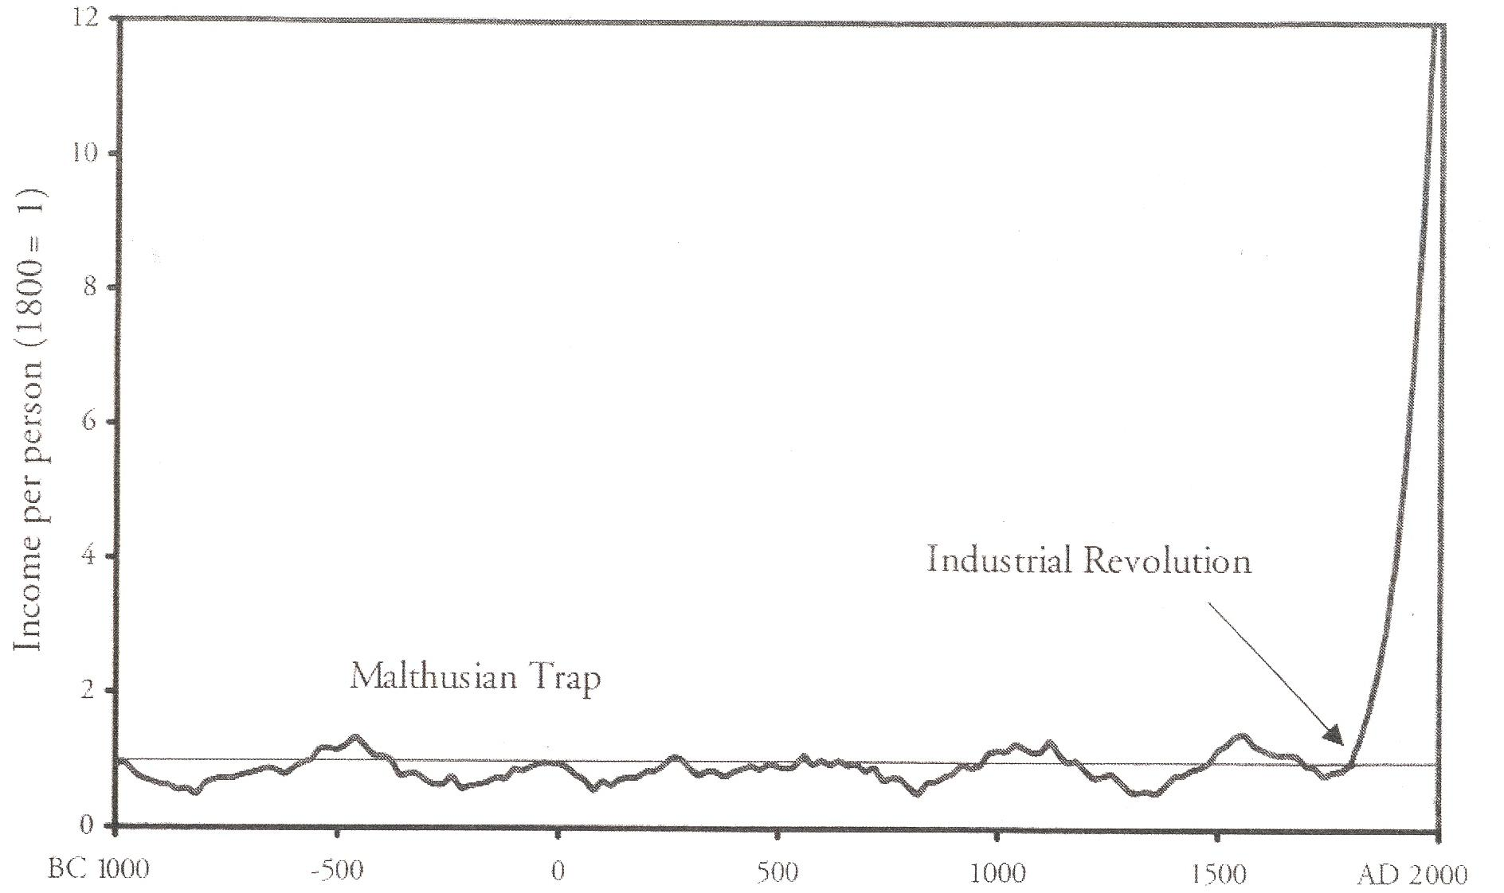

Slide 9
What is growth?
Improved Productivity

Slide 10
What is growth?
Improved Productivity
  One person can produce more = choices
    1870 – 70-80% working in agriculture (USA)
    2008 - <2% - output 18 x 1870’s
    Unemployment 1870’s - 6%, 2008 (ish) = 6%

Slide 11
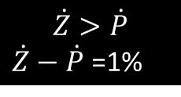
$$\dot{Z}>\dot{P}$$
$\dot{Z}−\dot{P}$ =1%

Slide 12
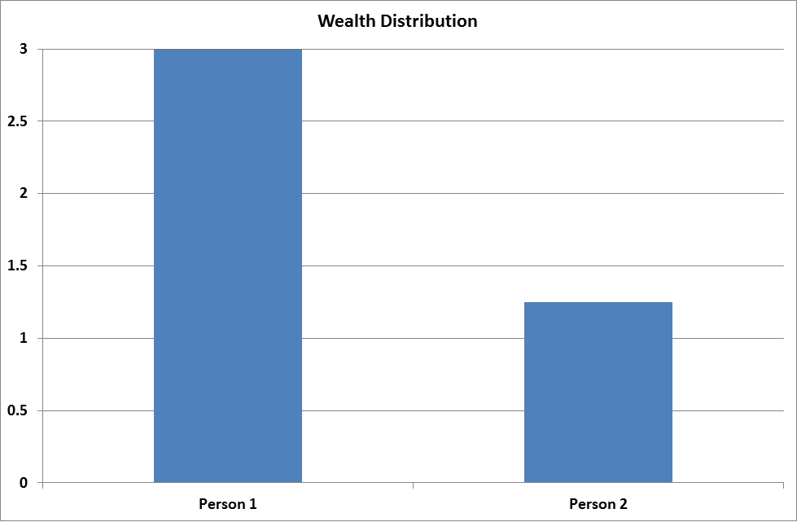
Zero Sum?

Slide 13
Yes but but but
Wealth ≠ welfare
What about population growth?
What about pollution/climate change?
The world can’t have more growth
People buy rubbish
What about inequality?
What about sweat shops?
GDP isn’t a good measurement of wealth
………………………..

Slide 14
Yes but but but
Wealth ≠ welfare
What about population growth?
What about pollution/climate change?
The world can’t have more growth
People buy rubbish
What about inequality?
What about sweat shops?
GDP isn’t a good measurement of wealth
………………………..

Slide 15
Econometrics
Correlation ≠ Causality

Slide 16
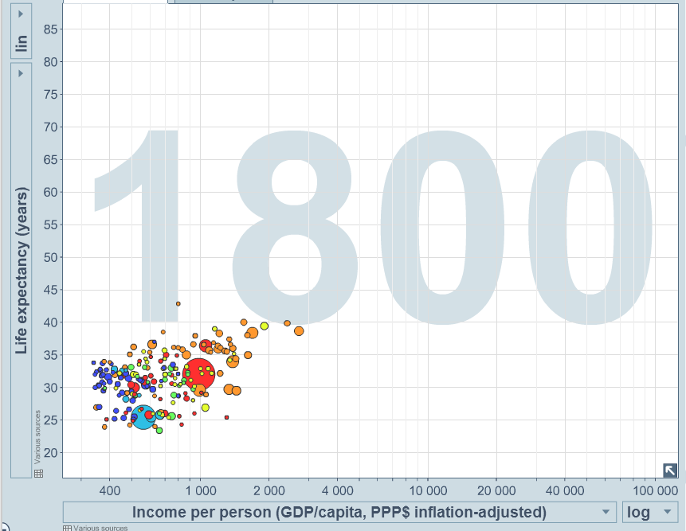
Life Expectancy

Slide 17
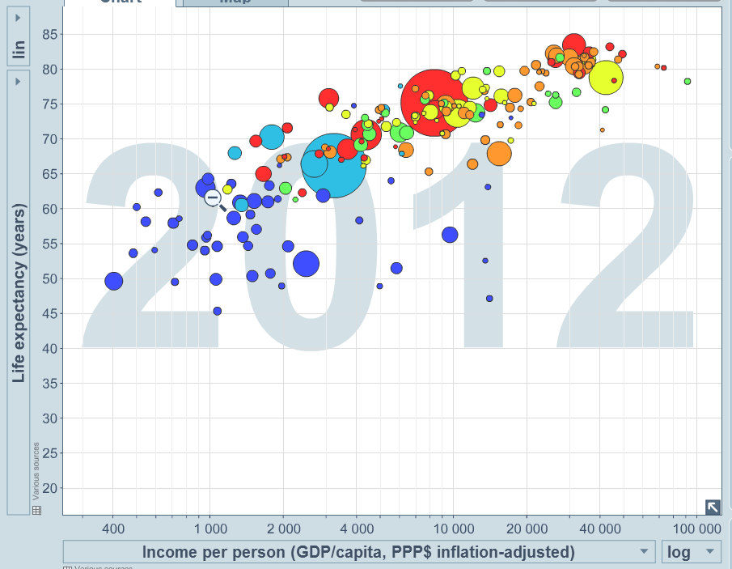
Life Expectancy

Slide 18
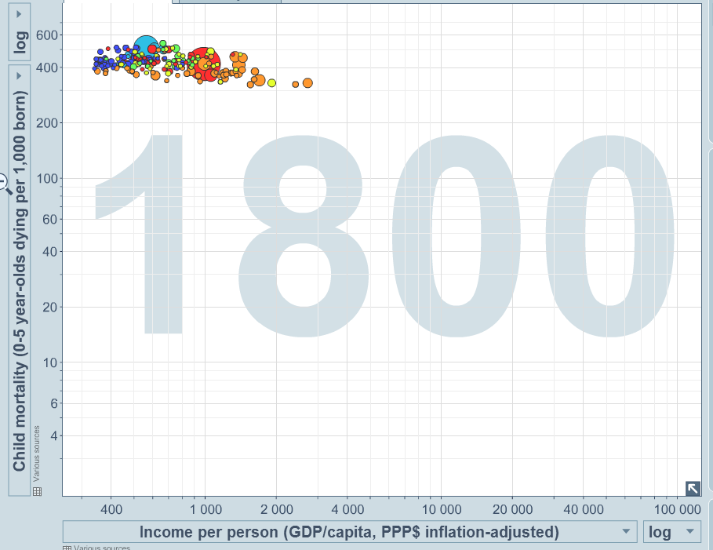
Infant Mortality

Slide 19
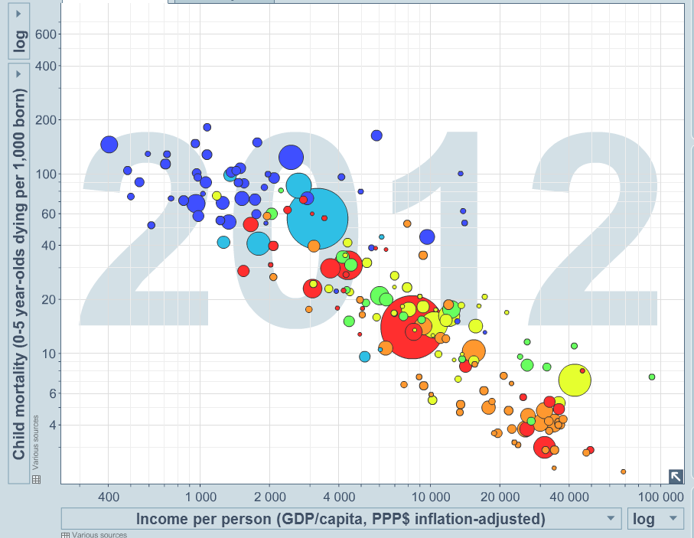
Infant Mortality

Slide 20
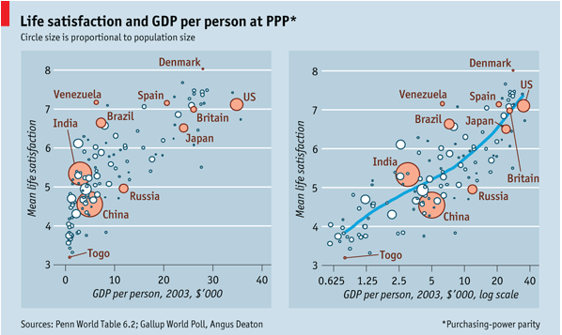
Happiness

Slide 21
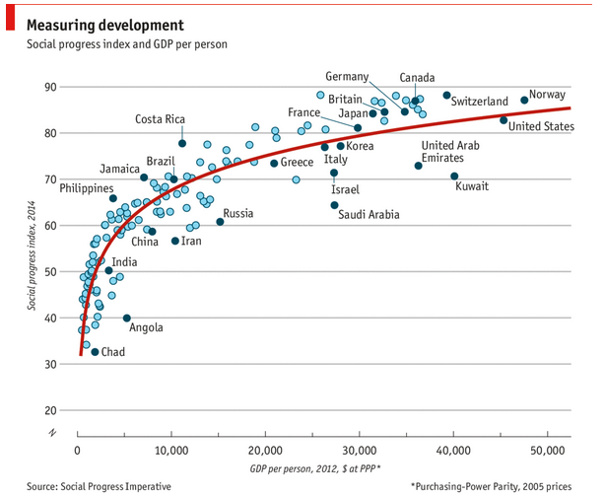
Social Progress

Slide 22
Yes but but but
Wealth ≠ welfare
What about population growth?
What about pollution/climate change?
The world can’t have more growth
People buy rubbish
What about inequality?
What about sweat shops?
GDP isn’t a good measurement of wealth
………………………..

Slide 23
Lets All Share
(a) ¼ of NZ
(b) ½ of NZ
(c) Same as NZ ($30K/person)
(d) 2x NZ (USA)
(e) 3x NZ (LUX)

Slide 24
Lets All Share
(a) ¼ of NZ
(b) ½ of NZ Where we are
(c) Same as NZ
(d) 2x NZ (USA)
(e) 3x NZ (LUX)

Slide 25
Lets All Share – in 25 years
(a) ¼ of NZ
(b) ½ of NZ Where we are
(c) Same as NZ 2.8%
(d) 2x NZ (USA) 5.7%
(e) 3x NZ (LUX) 7.4%

Slide 26
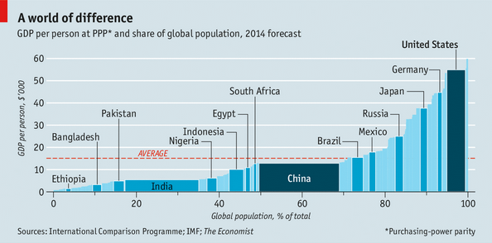
The current position

Slide 27
Two Questions
Should we have more growth?
  so everyone gets the same chances

Slide 28
Two Questions
Should we have more growth?
  so everyone gets the same chances
Can we get more growth?
  how to get growth?

Slide 29
Different Reality

Slide 30
Different Reality
Still think/behave like we are operating here

Slide 31
How about some theology?

Slide 32
Biblical revision?

Slide 33
What needs review?
Charging of interest
Year of jubilee
Attitude to wealth accumulation

Slide 34
Get with the picture
Pre 1800’s Ethics - God says ………

Slide 35
Get with the picture
Pre 1800’s Ethics - God says ………
Post 1800’s Ethics - Growth is a good thing?
  Property Rights
  Institutions
  Capital Markets
  Co-operation

Slide 36
Get with the picture
Pre 1800’s Ethics - God says ………
Post 1800’s Ethics - Will this effect growth?
  Property Rights
  Institutions
  Capital Markets
  Co-operation
Example - Anti slavery arguments pre and post 1800’s

Slide 37
Difficult Question
Why so long?

Slide 38
Possible extra slides
These did not end up getting used

Slide 39
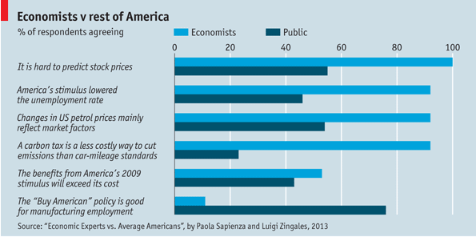
Image Problems

Slide 40
Theme 1
Foundations of economics

Slide 41
What is growth?
Improved Productivity
  One person can produce more = choices
    1870 – 70-80% working in agriculture (USA)
    2008 - <2% - output 18 x 1870’s
    Unemployment 1870’s - 6%, 2008 (ish) = 6%
More efficient

Slide 42
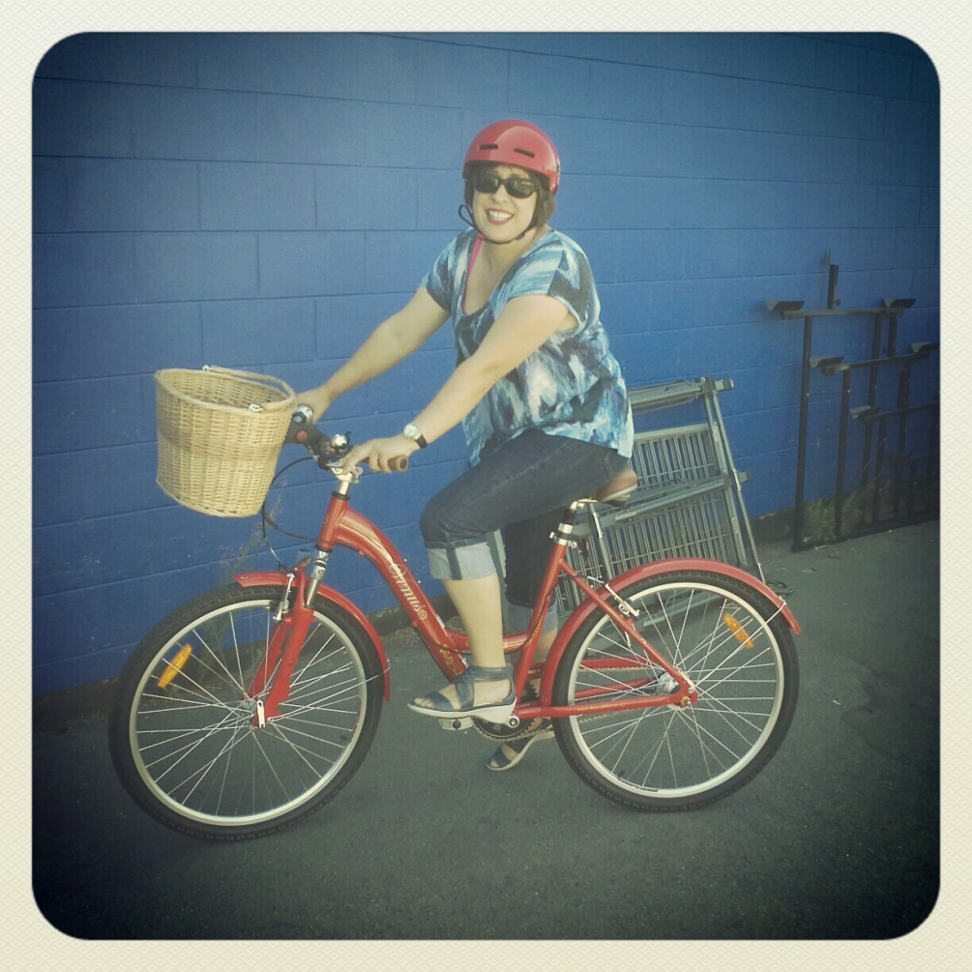

Which do you prefer?

Slide 43
Which do you prefer?

Slide 44
Which do you prefer?
Rusty Chain

